Slide 1


DAYANANDA SAGAR UNIVERSITY
SCHOOL OF ENGINEERING
Department of Computer Science and Engineering (AIML)
Major Project Phase-II Review II
DIABETIC RETINOPATHY DETECTION USING VISION TRANSFORMER AND EFFICIENTNET
Under the Supervision
Prof. Bahubali
Presented By:
Srinidhi R | ENG22AM3007
Srikeerthi Bandi | ENG22AM3006
Sanda Reddy Sai Chandan | ENG21AM0108
O Sowmyanath Sharma | ENG21AM0082

Slide 2
Overview
Introduction
Problem Definition and Objectives
Mention Base Paper and Novelty of Proposed Work
Detailed Methodology with Architectural Diagram
Experimentation
Comparison of Results with Graphical Representation
Future Enhancement for the next review
References

Slide 3

Sustainable Development Goals (SDGs)
Good health and well-being (SDG 3)
Early Detection: Enables timely treatment to prevent vision loss.
Affordable Care: Reduces the cost of manual diagnosis, making healthcare accessible.
Empowers Professionals: Assists healthcare workers in making accurate diagnoses.
3 of 12

Slide 4
Introduction
Diabetic Retinopathy
Diabetic retinopathy is a complication of diabetes that affects the eyes. It’s caused by damage to the blood vessels of the light-sensitive tissue at the back of the eye (retina). The disease progresses in stages, which are reflected in the dataset's severity labels:
Stage 0 (No DR): No signs of diabetic retinopathy.
Stage 1 (Mild DR): Minor signs of swelling in the retina's blood vessels.
Stage 2 (Moderate DR): The condition progresses, and some blood vessels may block.
Stage 3 (Severe DR): Many blood vessels are blocked, leading to retinal damage.
Stage 4 (Proliferative DR): New, abnormal blood vessels begin to grow, which can lead to blindness.

Slide 5
Problem Statement and Objectives
Problem: Detecting diabetic retinopathy through manual analysis of retinal images is time-consuming, requires specialized expertise, and may result in delayed or inaccurate diagnoses, risking patient vision.
Solution: The proposed solution leverages Vision Transformers (ViT) and EfficientNet to develop an automated system for detecting and classifying diabetic retinopathy. By combining EfficientNet's feature extraction and ViT's attention mechanisms, the model ensures accurate analysis of retinal images. Using transfer learning, it achieves high performance with efficient training, enabling reliable classification of diabetic retinopathy severity levels, supporting early detection, and reducing the burden on healthcare professionals.

Slide 6
Base Paper and Novelty :
Title: "Yang et al. (2024): The study proposed a Vision Transformer (ViT) model combined with masked autoencoders to classify referable diabetic retinopathy using large retinal images. The approach demonstrated superior performance due to its ability to capture global features effectively
.
Novelty of our Project:
Combines EfficientNet (local features) and Vision Transformer (ViT) (global features) for a hybrid model.
Tackles class imbalance using class-weighted loss functions.
GUI Integration: The system incorporates a user-friendly interface developed using Django and TypeScript, ensuring seamless interaction for healthcare professionals and ease of access to diagnostic results.

Slide 7
Dataset
The APTOS 2019 Blindness Detection dataset is a public dataset used for training models to classify images of retinas into different stages of diabetic retinopathy.
The dataset consists of color fundus images of retinas.
Dataset Structure:
Training Set: 70% of the data (2,563 images)
Validation Set: 30% of the data (1,099 images)
0: No diabetic retinopathy (1,805 images)
• 1: Mild diabetic retinopathy (370 images)
• 2: Moderate diabetic retinopathy (999 images)
• 3: Severe diabetic retinopathy (193 images)
• 4: Proliferative diabetic retinopathy (295 images)
Dept of CSE (AIML), SOE-Dayananda Sagar University

Slide 8
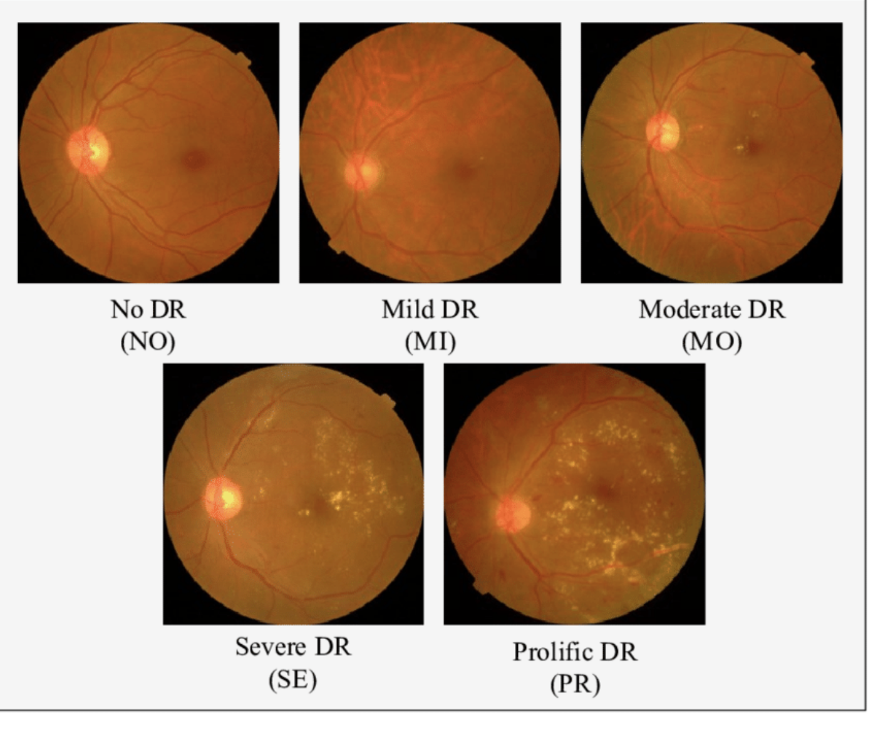
Dataset
Dept of CSE (AIML), SOE-Dayananda Sagar University

Slide 9
Image preprocessing
Image Preprocessing
Resizing: All images were resized to 224 x 224 pixels to meet the input requirements of Vision Transformers (ViT).
Patching Mechanism: Images were divided into smaller patches by the ViT model, enabling effective spatial relationship analysis.
Class Imbalance Handling: Class weights were calculated based on dataset distribution and incorporated into the loss function to ensure fair representation of minority classes
Data Augmentation: Techniques such as random rotations, zooming, horizontal flipping, and brightness adjustments were applied to increase dataset diversity.
Normalization: Pixel intensity values were normalized to standardize inputs and optimize model performance.
Dept of CSE (AIML), SOE-Dayananda Sagar University

Slide 10
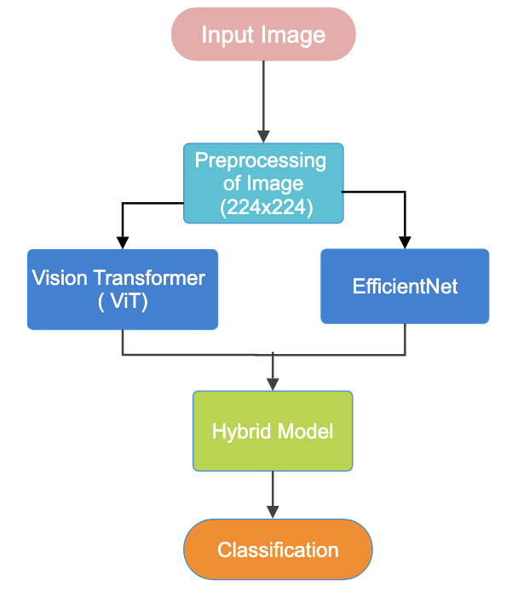
Model
We use Vision Transformers (ViT) and EfficientNet, forming a hybrid model that combines ViT's ability to treat image classification as a sequence modeling problem with EfficientNet's powerful feature extraction capabilities.
Dept of CSE (AIML), SOE-Dayananda Sagar University

Slide 11
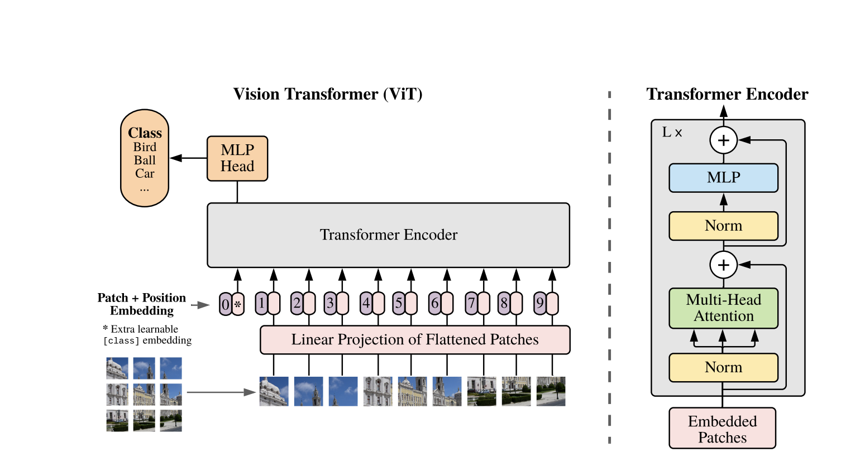
Model
Dept of CSE (AIML), SOE-Dayananda Sagar University

Slide 12
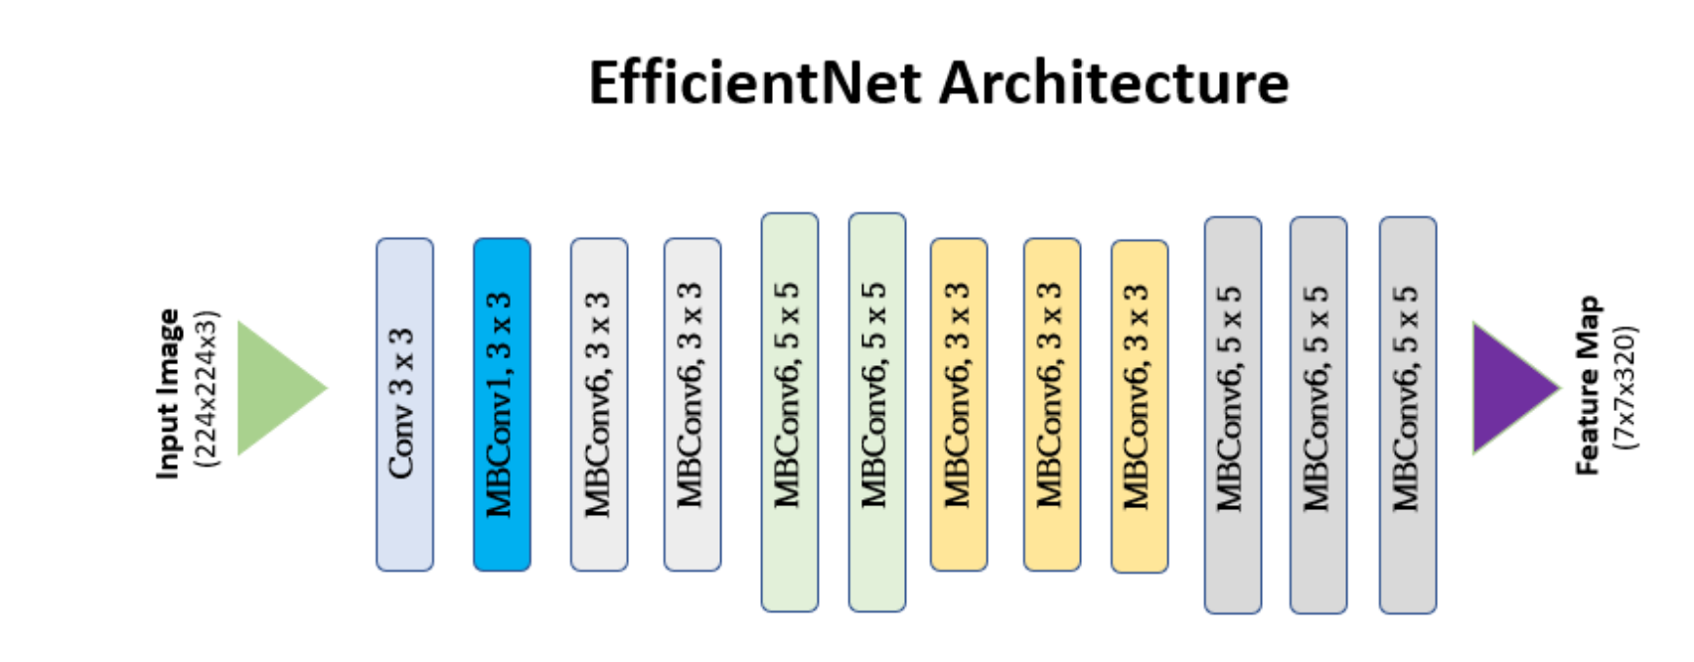

Slide 13
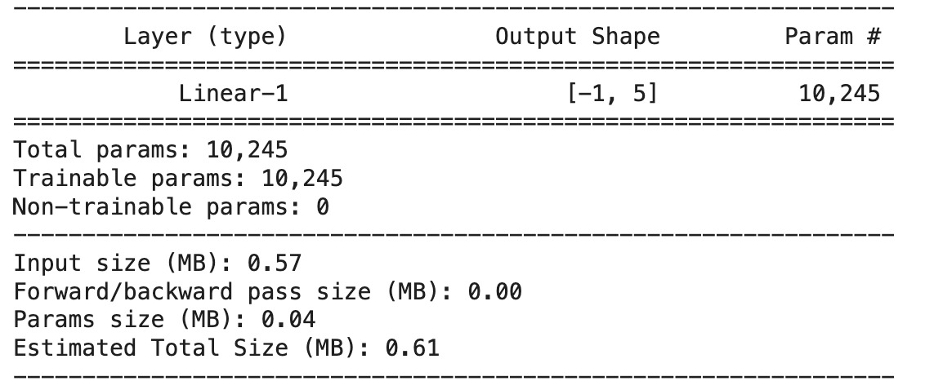
Architecture in detail with Hyperparameters
Architecture:
Input Image (224x224)
Preprocessing of Image (224x224)
Vision Transformer (ViT)
Forms patch embeddings, uses Transformer Encoder
Transformer Encoder
Processes ViT output with attention and feedforward layers
Combines MLP, normalization, and multi-head attention
Includes EfficientNet component
Classification output

Slide 14
Architecture in detail with Hyperparameters
Hyperparameters:
Model:
Input Image Size: 224x224 pixels
ViT Patch Size: 16x16 pixels (14x14 grid of patches)
ViT Depth: 12 Transformer blocks
ViT Heads: 12 attention heads
ViT Dimension: 768
Transformer Encoder Depth: 12 blocks
Transformer Encoder Heads: 12 attention heads
Transformer Encoder Dimension: 768
MLP Dimension: 3072
EfficientNet Model: EfficientNet-B3
Optimization: AdamW with a learning rate of 1e-4
Batch Size: 32
Training Epochs: 10

Slide 15
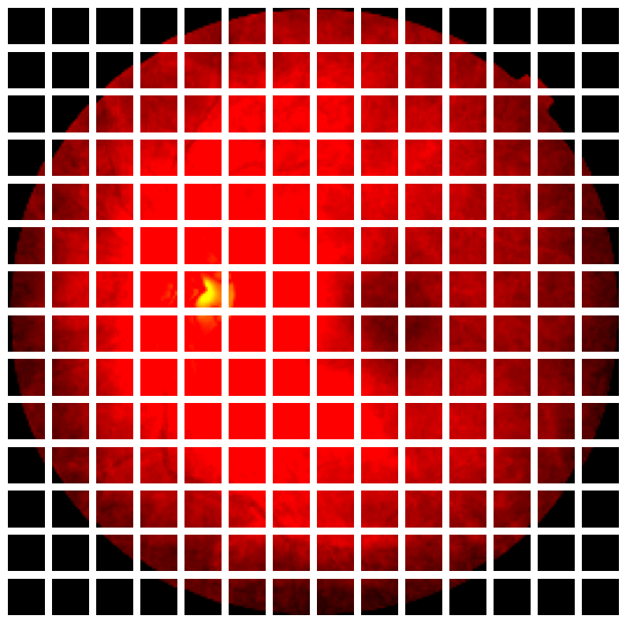
Results
The grid represents how the image is split into smaller patches, which are processed individually by the Vision Transformer model. Each patch corresponds to a portion of the image that the model attends to when making

Slide 16
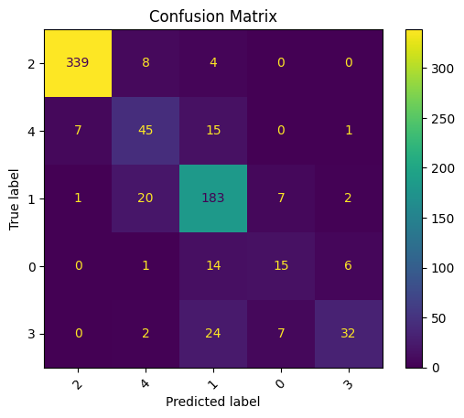
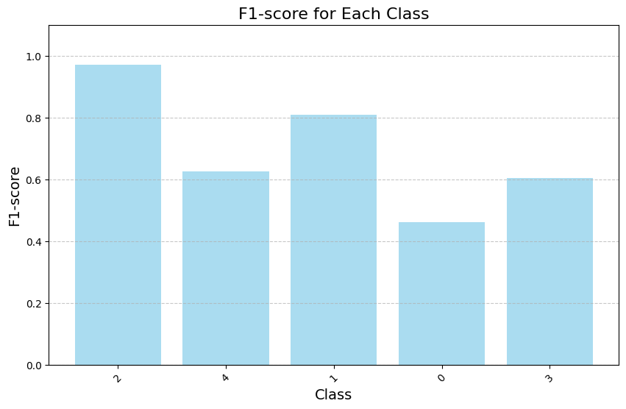
Results

Slide 17
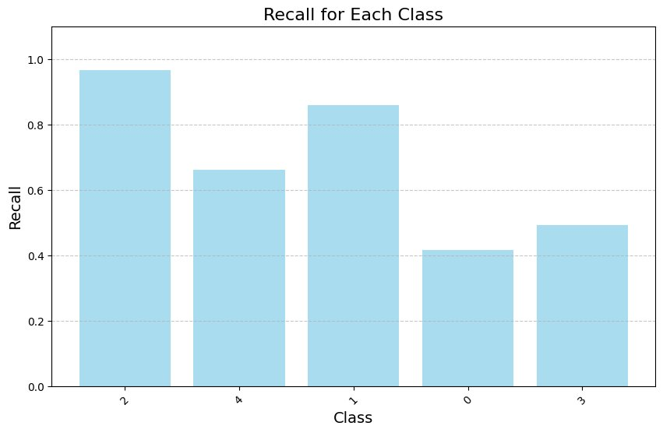
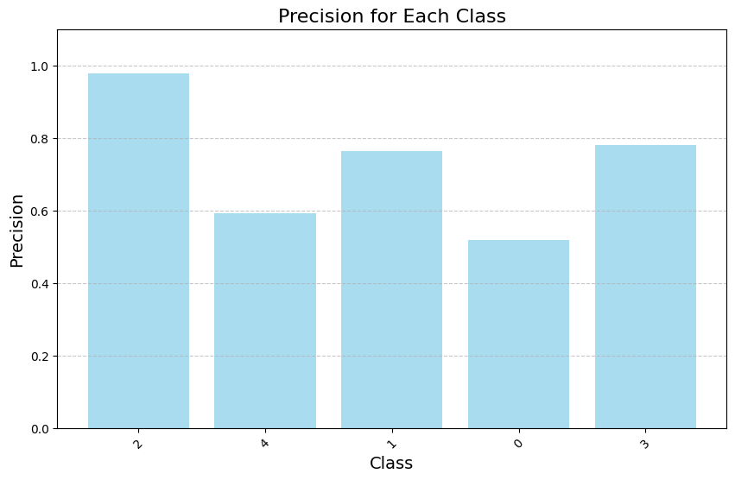
Results

Slide 18
Results
Confusion Matrix:
Class 2 (Moderate DR): Best performance with 339 correctly classified samples and very few misclassifications.
Class 4 (Proliferative DR): Struggles with misclassifications, particularly being predicted as Class 2 or Class 1.
Class 0 (No DR): High confusion, with many samples misclassified into Classes 1 and 2.
Class 3 (Severe DR): Moderate performance but significant confusion with Class 2.
Precision (Bar Chart):
Highest: Class 2 (~1.0) indicating excellent precision for Moderate DR.
Lowest: Class 0, showing difficulty in correctly identifying images with no DR.
Recall (Bar Chart):
Highest: Class 2 (~1.0) highlights almost all Moderate DR samples being correctly identified.
Lowest: Class 0, indicating many No DR cases were missed or misclassified.
F1-Score (Bar Chart):
Best: Class 2, achieving a balanced precision and recall.
Poor Performance: Class 0 and Class 4, reflecting the need for better handling of these underrepresented classes.

Slide 19
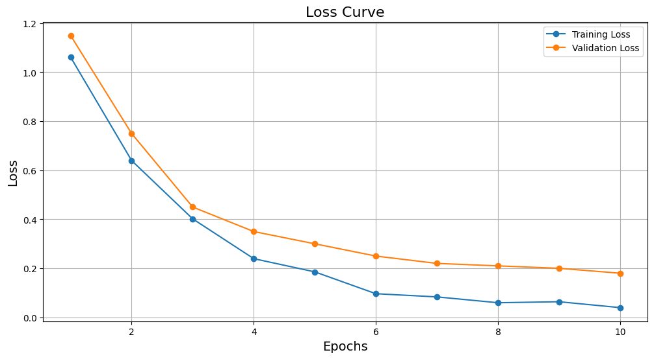
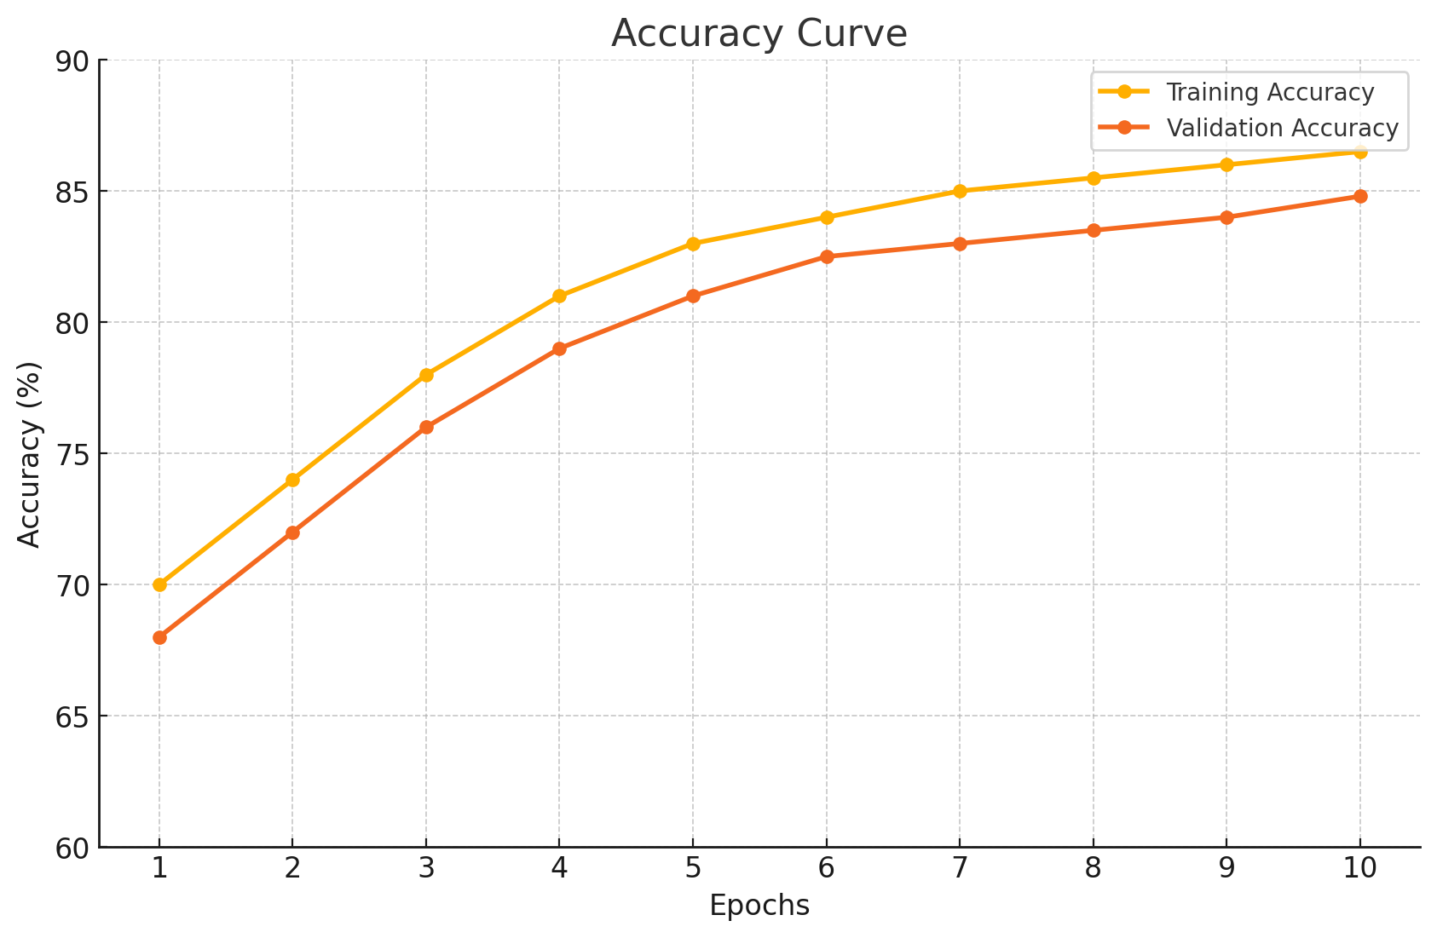
Results
Loss Curve:
The gradual reduction in loss over epochs indicates effective learning, with minimal overfitting as the training and validation losses converge.
• Accuracy Curve:
The accuracy steadily increases over epochs, highlighting the model’s ability to generalize well across the validation set

Slide 20
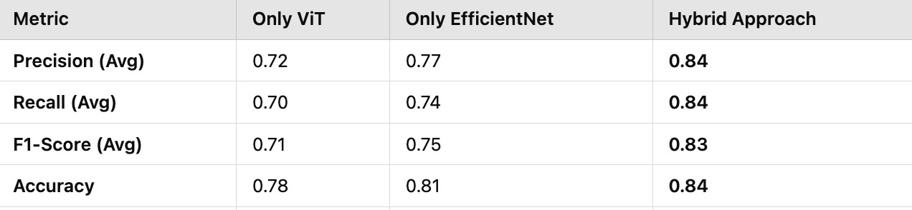
comparision with Vit , EfficientNet and Hybrid approch with metrics

Slide 21
Future Enhancement – Planned for Next Review
Utilizing real-time datasets: Future work will involve using real-time hospital datasets to evaluate and validate the system’s performance in clinical environments.

Slide 22
References
Dosovitskiy, A., Beyer, L., Kolesnikov, A., Weissenborn, D., Zhai, X., Unterthiner, T., ... & Houlsby, N. (2021). "An Image is Worth 16x16 Words: Transformers for Image Recognition at Scale." arXiv preprint arXiv:2010.11929.
Mutawa, A. M., Alnajdi, S., & Sruthi, S. (2023). "Transfer Learning for Diabetic Retinopathy Detection: A Study of Dataset Combination and Model Performance." Applied Sciences, 13(9), 5685.
He, K., Zhang, X., Ren, S., & Sun, J. (2016). "Deep Residual Learning for Image Recognition." Proceedings of the IEEE Conference on Computer Vision and Pattern Recognition (CVPR), 770–778.
Jha, D., Riegler, M., Johansen, D., Halvorsen, P., & Johansen, H. D. (2021). "Vision Transformer for Diabetic Retinopathy Detection." Computers in Biology and Medicine, 130, 104218.
Touvron, H., Cord, M., Douze, M., Massa, F., Sablayrolles, A., & Jégou, H. (2021). "Training Data-efficient Image Transformers and Distillation through Attention." International Conference on Machine Learning (ICML).

